Slide 1

National Institute of Technology Agartala
Department of Production Engineering
Presentation on Babcock and Wilcox Boiler
by Group 4

Slide 2
0
Members
Biswajoy Bhattacharjee, 21UPE028
Surya Kant, 21UPE028
Girindra Naik, 21UPE028
Group 4
Sai, 21UPE028
Kalyan, 21UPE028
Lakshya, 21UPE028

Slide 3
1
What is a Boiler?
Vessel that heats water to become hot water or steam.
At atmospheric pressure water volume increases 1,600 times.
Hot water or steam used to transfer heat to a process.

Slide 4
2
PRINCIPLE OF OPERATION
The boiler is essentially a closed vessel inside which water is stored. Fuel (generally coal) is burnt in a furnace and hot gasses are produced.
These hot gasses come in contact with water vessel where the heat of these hot gases transfer to the water and consequently steam is produced in the boiler.
This steam is piped to the turbine of thermal power plant.

Slide 5
3
General Classification
Fire Tube
Water Tube
In the fire tube boilers, the hot gases are inside the tube and water surrounds the tubes. for example Cochran, Lancashire and locomotive boilers.
In the water tube boilers, the water is inside the tubes and hot gases surrounds them. For example Babcock and Wilcox, Stirling, Yarrow boiler etc.

Slide 6
4
Fire Tube Boiler
Relatively small steam capacities (12,000 kg/hour).
Low to medium steam pressures (18 kg/cm2).
Operates with oil, gas or solid fuels.

Slide 7
5
Fire Tube Boiler
Advantages
It is quite compact in construction.
Fluctuation of steam demand can be met easily.
It is also quite cheap.
Disadvantages
As the water required for operation of the boiler is quite large, it requires long time for rising steam at desired pressure.
As the water and steam are in same vessel the very high pressure of steam is not possible
The steam received from fire tube boiler is not very dry.

Slide 8
6
Water Tube Boiler
Used for high steam demand and pressure requirements.
Capacity range of 4,500 - 120,000 kg/hour.
Combustion efficiency enhanced by induced draft provisions.

Slide 9
7
Water Tube Boiler
Advantages
Larger heating surface can be achieved by using more numbers of water tubes.
Due to convectional flow, movement of water is much faster than that of fire tube boiler; hence rate of heat transfer is high which results into higher efficiency.
Very high pressure in order of 140 kg/cm? can be obtained smoothly.
Disadvantages
The main disadvantage of water tube boiler is that it is not compact in construction.
Its cost is not cheap.
Size is a difficulty for transportation and construction.

Slide 10
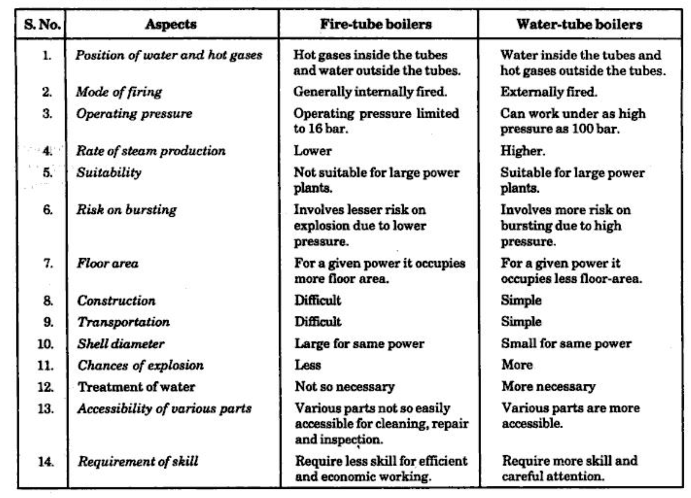
8
Comparison

Slide 11
9
Babcock and Wilcox Boiler
INTRODUCTION | CONSTRUCTION | WORKING | ADVANTAGES

Slide 12
10
Introduction
This is an example of water tube boiler and is used in stationary and marine engine.
The efficiency of this boiler is much greater than that of the fire tube boiler.
This boiler is used when pressure is above 10bar and steam generating capacity is required higher then 7000kg/hr.

Slide 13
11
Construction
The Babcock & Wilcox boiler is a type of water-tube boiler, in which water is circulated inside tubes that are surrounded by hot combustion gases.
The tubes are arranged in several nested layers, with the hottest gases in the outermost layer and the coolest water in the innermost layer.
The combustion of fuel (typically coal, oil, or natural gas) takes place in a furnace at one end of the boiler, and the hot gases produced by combustion flow through the tubes to transfer heat to the water.

Slide 14
12
Construction
The steam generated by the boiling water rises to the top of the boiler, where it can be used to power a turbine or other mechanical device.
The Babcock & Wilcox boiler is known for its high reliability, efficient heat transfer, and low fuel consumption.
The boiler also typically includes various safety systems such as a pressure relief valve and a low water cutoff to prevent damage or accidents.

Slide 15
13
Working
The water is fed into the drum through the feed check valve.
Due to gravity, water passes through the short riser tube.
Then water collects in the drum. Initially one half of the drum is filled up with water.
The baffles plates make flow of hot gases in sine wave form.

Slide 16
14
Working
The damper control the flow of air into the furnace.
Water is heated by hot gases coming from furnace. Due to heating of water density of water decreases. Low density water move upwards in water tube and finally water converted into the steam.
This cycle repeat continuously.
The steam flows in superheater tubes and is finally taken out through the main steam stop valve and supplied to the engine when needed
In the end of the process mud collector is provided to remove the mud particles through a blow down cock.

Slide 17
15
Advantages
The boiler's steam generation capacity is very high about 2000 to 40000 kg/hr
Maintenance is easy
Can be used in heavy industries requiring large amount of steam

Slide 18
National Institute of Technology Agartala
Department of Production Engineering
Thank You

